Slide 1

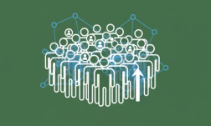

DeepVision Crowd Monitor:
AI for
Density Estimation and Overcrowding
Detection
Created by:
Aarish Bhanwadia

Slide 2
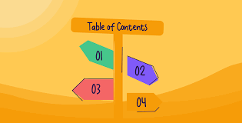

Project Overview
Dataset Overview & Key Insights
Methodology
Exploratory Data Analysis (EDA)
Visualizations
Data Preprocessing
Feature Extraction
Model Architecture
Training & Evaluation
Results
User Interface
Challenges
Future Scope
Conclusion

Slide 3

Project Overview
Goal: Develop a real-time AI system that estimates crowd density and automatically detects overcrowding using live surveillance camera feeds.
Purpose: ✔ Improve public safety ✔ Support emergency response ✔ Optimize crowd flow ✔ Enable smart city monitoring
Used For:
Railways, metro stations
Public events
Malls, religious gatherings
Stadiums, airports

Slide 4
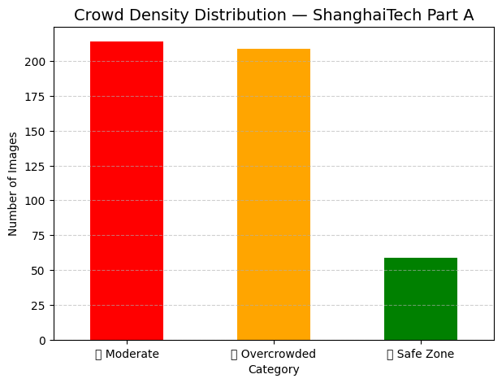
DATASET OVERVIEW & KEY INSIGHTS
Dataset Used:
ShanghaiTech Crowd Counting Dataset
Features:
Part A: Dense crowds (high variation)
Part B: Sparse scenes (outdoor)
High-quality labelled density maps
1198 annotated images
Key Insights:
Crowd distribution varies non-linearly
Traditional detection fails in dense scenes
Density maps provide better estimation
Illumination & occlusion are major challenges

Slide 5

Methodology
Deployment and Evaluation
Integrated UI
Webcam and Video input Dashboards and alerts added
Model development and Training
Data collection and Preprocessing

Slide 6
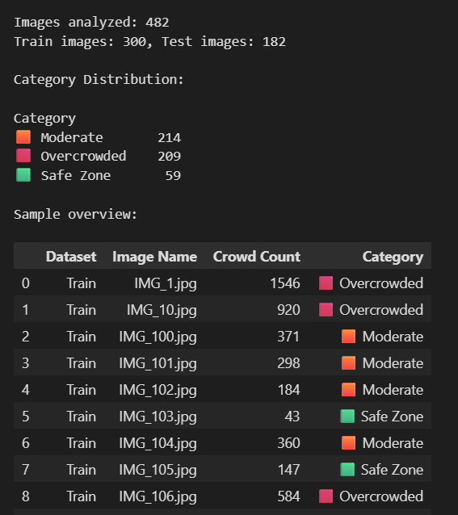
Exploratory Data Analysis
Performed analyses include:
Crowd distribution histograms
Count variability across scenes
Density map pattern visualization
Noise artifacts in raw frames
Variation due to lighting, angle, occlusion
Insights:
High-density images have smooth Gaussian-like blobs
Sparse images have isolated peaks
Strong correlation between intensity & count

Slide 7
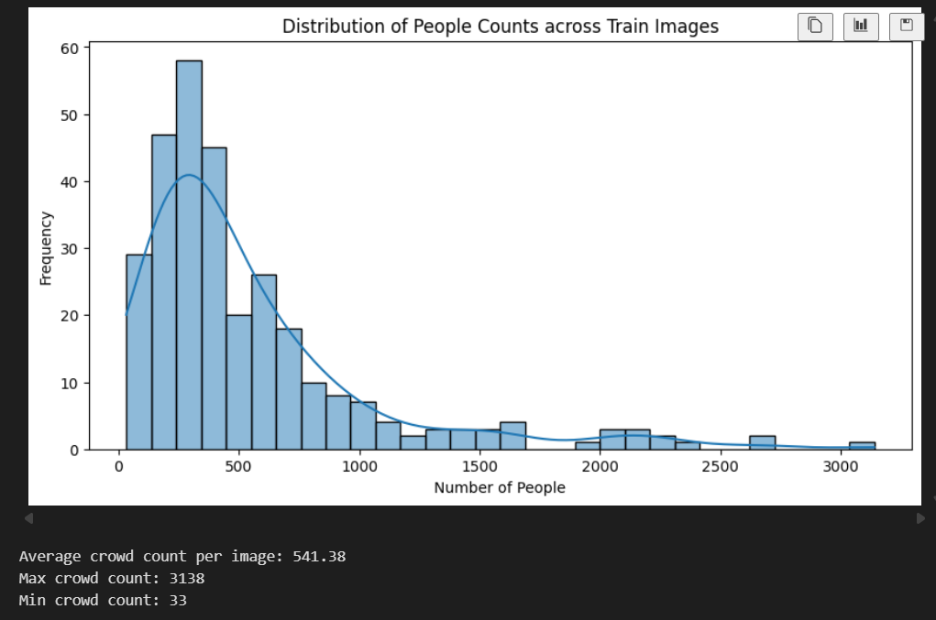
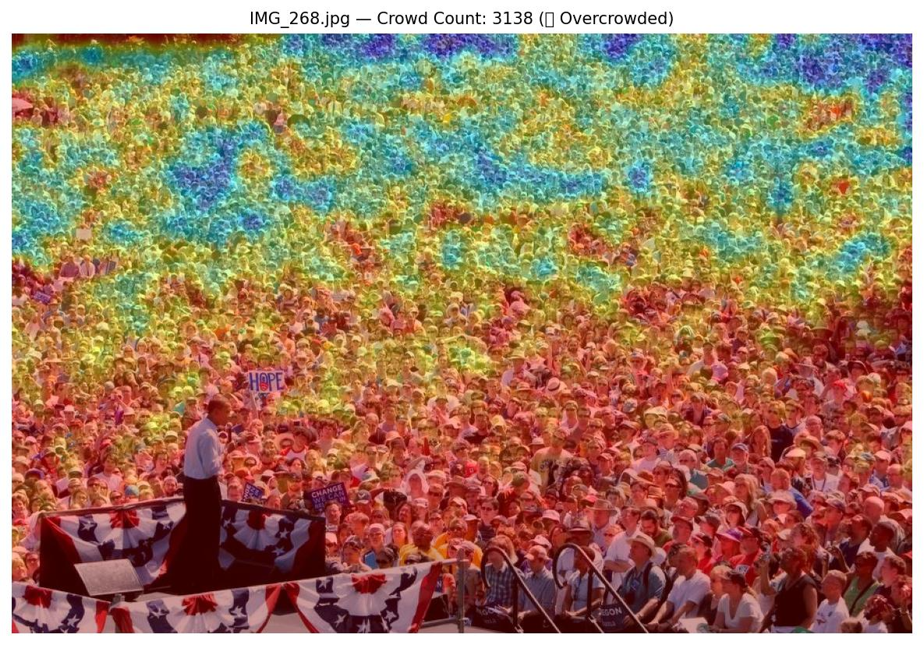
Visualization
Included:
Sample density maps vs. original image
Heatmaps overlaid on frame
Count progression graph during a video

Slide 8
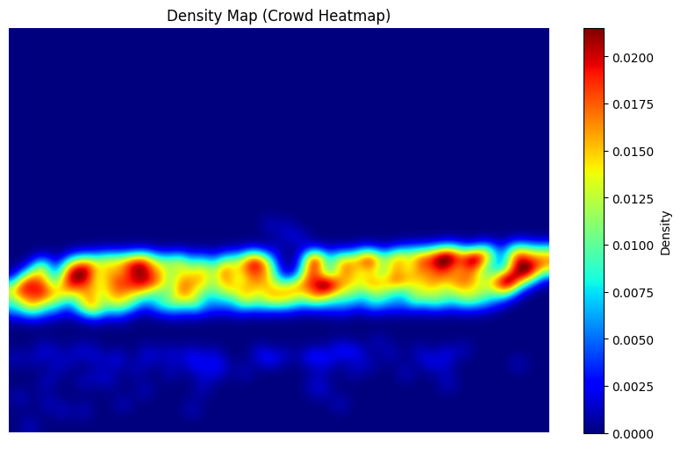





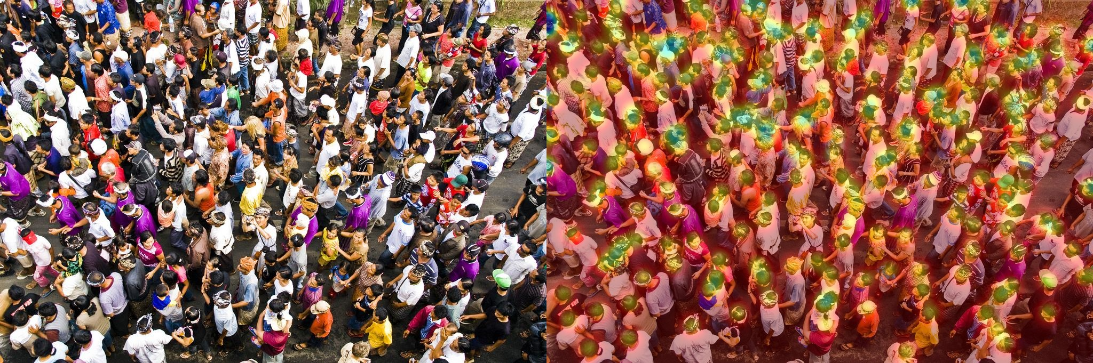

Data Preprocessing
Resizing images
Normalizing using ImageNet mean/std
Removing noisy frames
Converting frames to RGB
Preparing training/validation sets
Applying Gaussian smoothing (density maps)

Slide 9
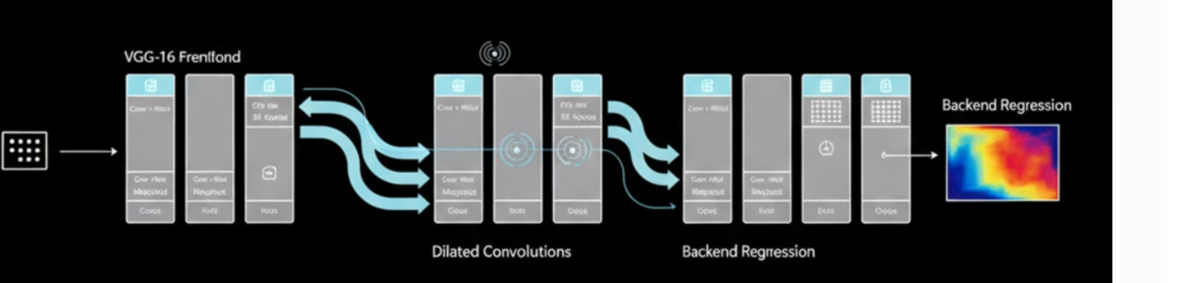
FEATURE EXTRACTION
FEATURE EXTRACTION
Discuss how CSRNet learns features:
VGG-16 frontend extracts spatial features
Dilated convolution layers expand receptive field
Back-end regression layers generate pixel-wise density
Features learned:
Texture
Density clusters
Fine-grained spatial variations
VGG-16

Slide 10
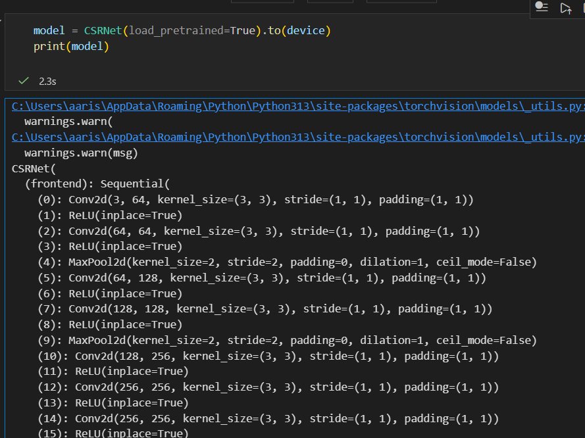
MODEL ARCHITECTURE (CSRNet)
Frontend:
Based on VGG-16
Convolution + ReLU layers
Backend:
Dilated convolutions
Larger receptive field
Suitable for dense crowds

Slide 11
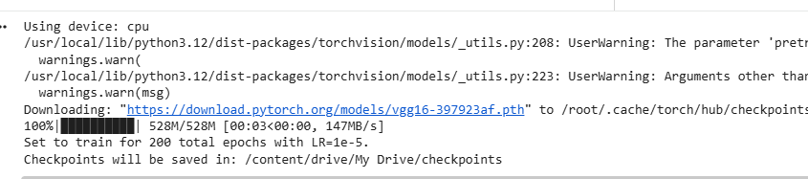
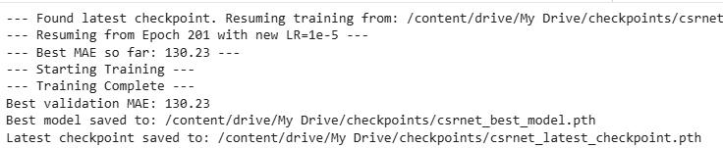
Model Training
Training Setup:
Framework: PyTorch
Optimizer: Adam
Loss: MSE (between predicted & ground truth density maps)
Epochs: 200
Evaluation Metrics:
MAE – Mean Absolute Error
MSE – Mean Squared Error

Slide 12
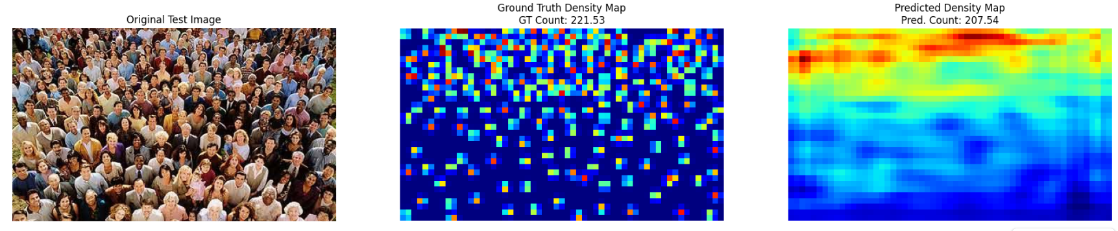
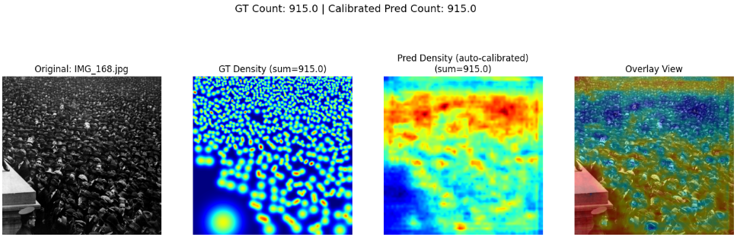
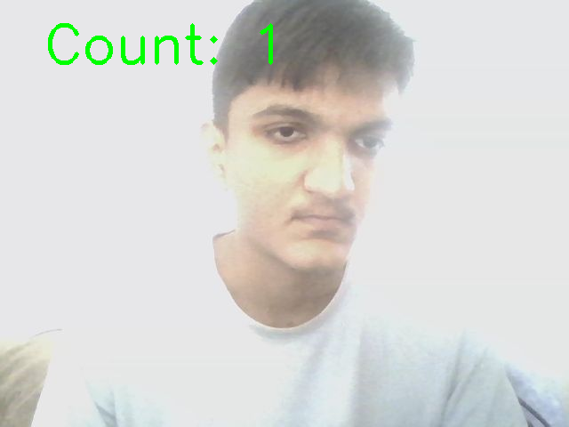
Results
✔ Real-time estimation achieved ✔ High accuracy on sparse & moderate crowds ✔ Overcrowding detection is reliable ✔ System works smoothly on GPU

Slide 13
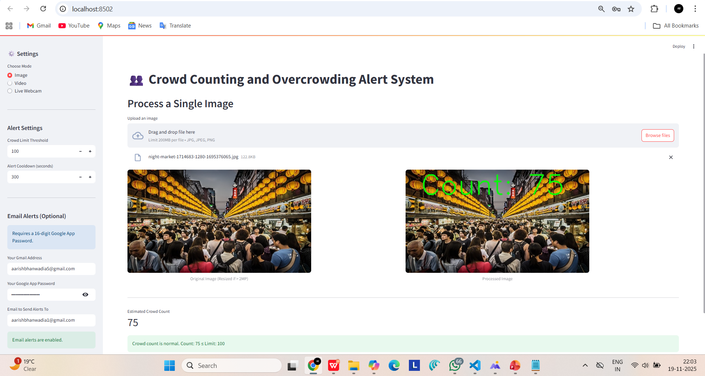
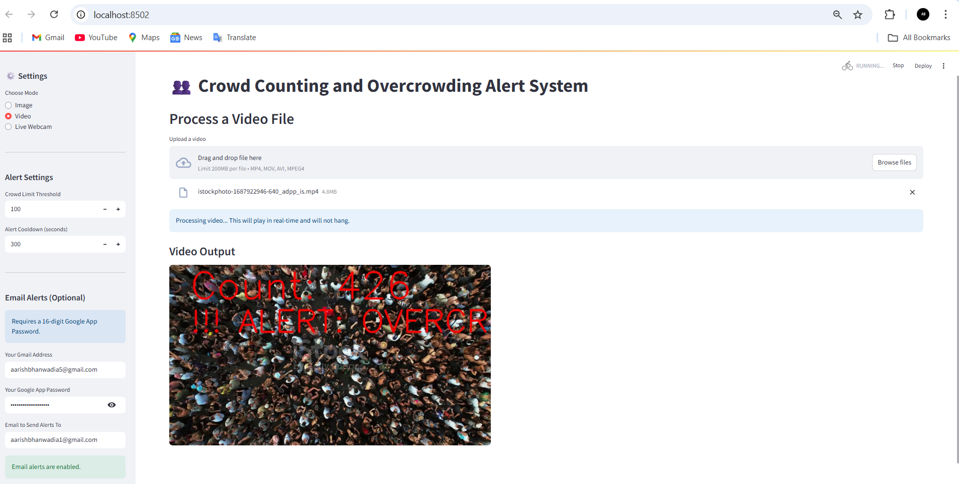
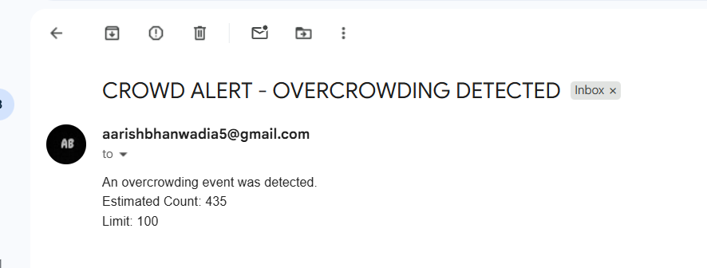
USER INTERFACE

Slide 14
Challenges
Variation in lighting conditions
High-density scenes → occlusion
GPU requirement for real-time
Dataset generalization issues
Noise in low-resolution CCTV feeds
Fine-tuning required for different environments

Slide 15
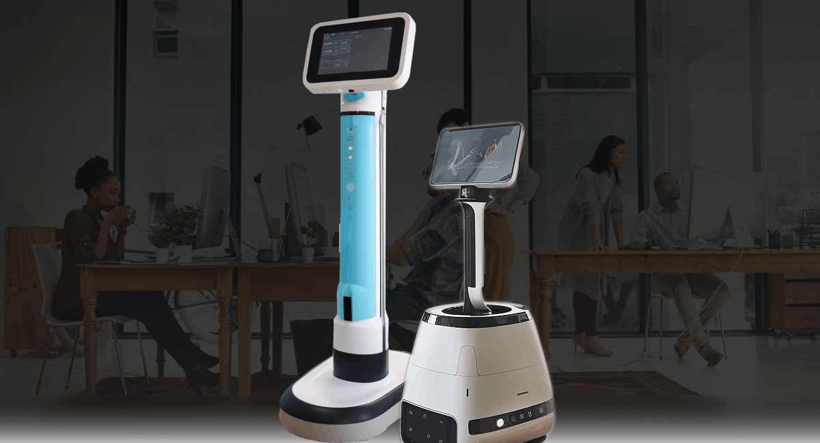

Future Work
Integration with drone surveillance
Multi-camera fusion
Predictive crowd flow forecasting
Cloud/Edge deployment
Integration with city emergency systems
Thermal + RGB fusion for night scenes

Slide 16
Conclusion
It was a truly wonderful experience working on this AI-based deep learning project from start to finish. Throughout the development of the DeepVision Crowd Monitor, I gained hands-on knowledge of modern computer vision techniques, density-estimation models, real-time video analytics, and deployment-ready deep learning pipelines. Each stage—dataset preparation, model training, integration, dashboard development, and alert automation—provided valuable insights and strengthened my understanding of how AI systems operate in real-world environments. Completing this project not only enhanced my technical skills but also boosted my confidence in building practical, impactful solutions that contribute to public safety and intelligent monitoring applications.

Slide 17


Mentor and Team
InfosysSpringboard

